Slide 1




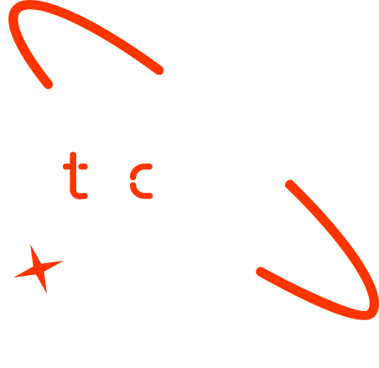
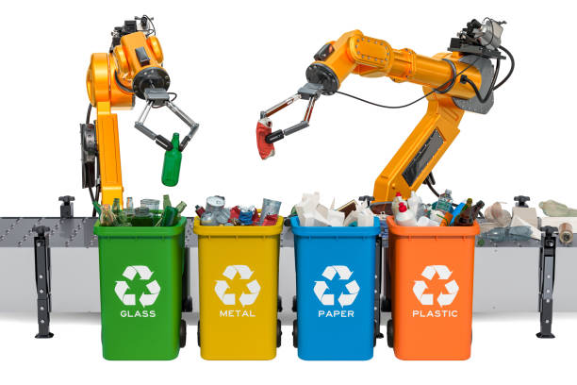

Real-Time Recycling Sorting Using Deep Learning
Group 8
June,2025

Slide 2

Outline
Concept note and implementation plan
Background
Objectives
SDG Relation
Data
Data Collection
Exploratory Data Analysis et Feature Engineering
Model
Model Selection and Training
Model Evaluation and Hyperparameter Tuning
Model Refinement and Testing
Results
Evaluation Results
Deployment
Future Work

Slide 3
Concept note and Implementation Plan

Slide 4
Background
Traditional waste sorting depends on manual labor, leading to slow processes, high costs, and health risks.
Errors in sorting cause recyclable materials to be thrown away.
This project uses computer vision and deep learning to build a real-time system that accurately detects and classifies waste, improving efficiency and recycling effectiveness.

Slide 5
Objectives
General Objective To develop a real-time deep learning system that automatically classifies and sorts different types of waste using image data.
Specific Objectives
Preprocess and prepare the labeled TrashNet dataset for model training
Implement and compare deep learning models based on accuracy and speed
Select the best-performing model for real-time waste detection
Develop a simple web app for image-based waste classification
Evaluate the system in real-time scenarios for accuracy and reliability

Slide 6



SDG Relation
This project aligns with:
Primary Alignment:
SDG 12 (Responsible Consumption and Production): Promotes sustainable waste management by increasing recycling rates.
SDG 13 (Climate Action): Reduces landfill waste and associated greenhouse gas emissions.
Secondary Alignment:
SDG 11 (Sustainable Cities and Communities): Promotes cleaner cities by reducing improper waste disposal.

Slide 7
Data

Slide 8
Data Collection
Dataset Source: Kaggle TrashNet
Dataset size: 2,527 images across 6 categories
Classes: cardboard, glass, metal, paper, plastic, trash
Split: 80% train, 10% val, 10% test
Dataset Preprocessing: Normalization, Augmentation: rotation, flipping, zoom, brightness
Format Conversion: YOLO bounding box for object detection
Tools: Python, OpenCV, Roboflow, Google Drive, Google colab
Notes:
FTs like precision agriculture, remote sensing & AI-powered forming equipment can help increase agricultural productivity in LDCs. This can improve fiid security & contribute to the achievement of SDG 2 (Zero Hunger).

Slide 9
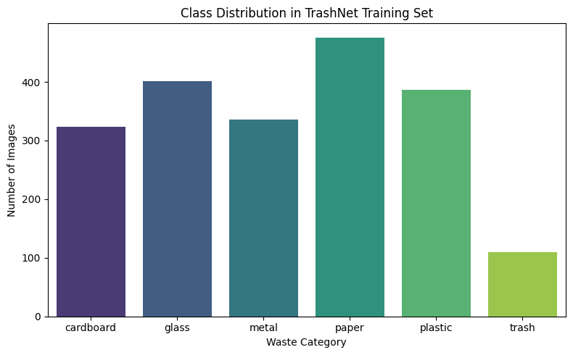
Exploratory Data Analysis and Feature Engineering
Class Distribution:

Slide 10
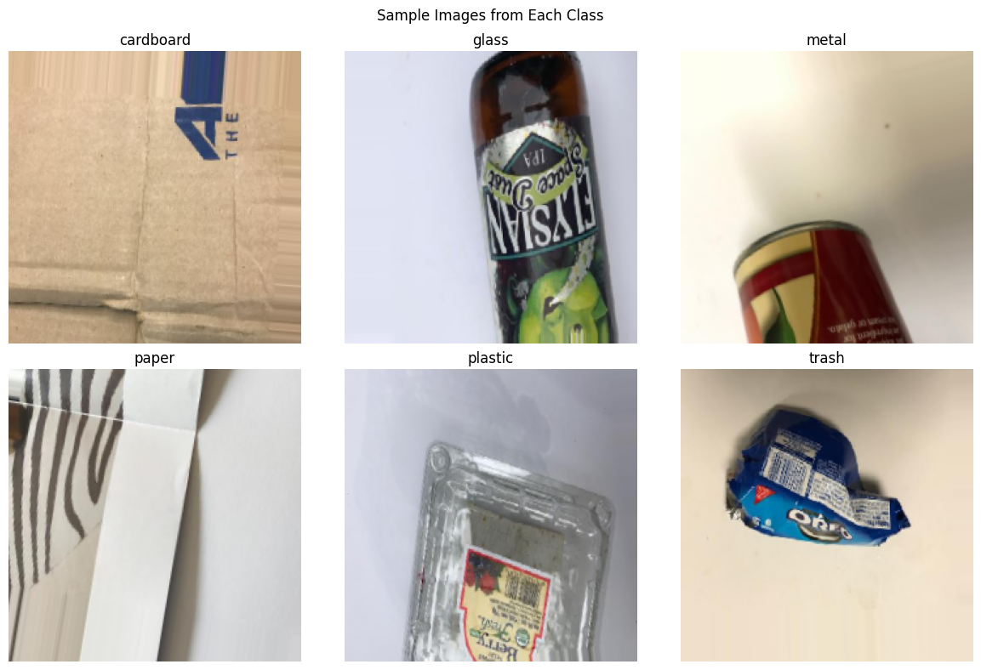
Exploratory Data Analysis and Feature Engineering
Sample Image Visualization:
Notes:
FTs like precision agriculture, remote sensing & AI-powered forming equipment can help increase agricultural productivity in LDCs. This can improve fiid security & contribute to the achievement of SDG 2 (Zero Hunger).

Slide 11
Model

Slide 12
Model Selection and Training
Models Trained
Custom CNN: A simple model with 3 layers, used as a baseline
EfficientNetB0: Fast and accurate, ideal for real-time and low-power devices
MobileNetV2: Lightweight model built for mobile performance
ResNet50: Deep model with strong feature extraction
Vision Transformer (ViT): Uses transformer architecture for detailed image understanding
YOLOv8: Real-time object detection model with high accuracy and speed

Slide 13
Model Evaluation and Hyperparameter Tuning
Evaluation Metrics:
Precision, Recall, mAP@0.5, and Accuracy
Compared six models: CNN, EfficientNet, MobileNet, ResNet, ViT, YOLOv8
Hyperparameter Tuning:
Learning Rate: Started at 0.001, fine-tuned to 0.0001
Batch Size: Tested 16–32
Epochs: Ranged from 5 to 50
Applied data augmentation for better generalization
Used early stopping & model checkpoints to prevent overfitting
YOLOv8: Tuned with default anchors & confidence threshold = 0.25

Slide 14
Model Refinement and Testing
Model Refinement:
Fine-tuned top-performing models (YOLOv8, ResNet50, ViT) using validation feedback.
Improved learning rate scheduling and batch normalization for stable convergence.
Applied data augmentation to minimize overfitting and improve robustness.
Reorganized dataset splits for better class balance across training, validation, and test sets.
Testing Process:
Performed final evaluation on unseen test data to measure generalization.
Used real-world images for prediction
Key metrics used: Precision, Recall, mAP, loss and Accuracy.
YOLOv8 consistently outperformed other models in both speed and detection accuracy.

Slide 15
Results

Slide 16
Evaluation Results
Model | Precision | Recall | mAP@0.5
Custom CNN | 0.820 | 0.800 | 0.840
EfficientNet | 0.870 | 0.850 | 0.890
MobileNet | 0.850 | 0.840 | 0.870
ResNet50 | 0.880 | 0.870 | 0.900
Vision Transformer (ViT) | 0.830 | 0.820 | 0.860
YOLOv8 | 0.863 | 0.931 | 0.956

Slide 17
Evaluation Results
Accuracy Comparison by Model
Model | Train Accuracy (%) | Val Accuracy (%) | Test Accuracy (%)
ViT | 99.65 | 96.84 | 96.05
MobileNet | 81.93 | 84.31 | 82.09
EfficientNet | 86.64 | 84.29 | 80.62
Custom CNN | 87.29 | 72.68 | 74.48
ResNet | 98.19 | 89.66 | 87.21

Slide 18
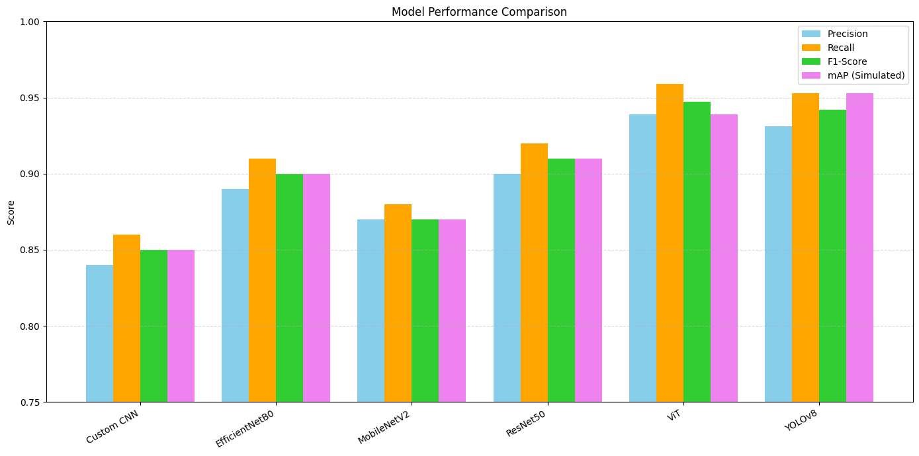
Evaluation Results
This helps highlight that YOLOv8 leads across all metrics, especially in Recall (93.1%) and mAP@0.5 (95.6%), making it an ideal model for your real-time recycling sorting use case.

Slide 19
Deployment
Developed a Streamlit UI for user interaction
Features:
Upload image or capture from webcam
Real-time classification using YOLOv8 and VIT
Deployed with ngrok for public access

Slide 20
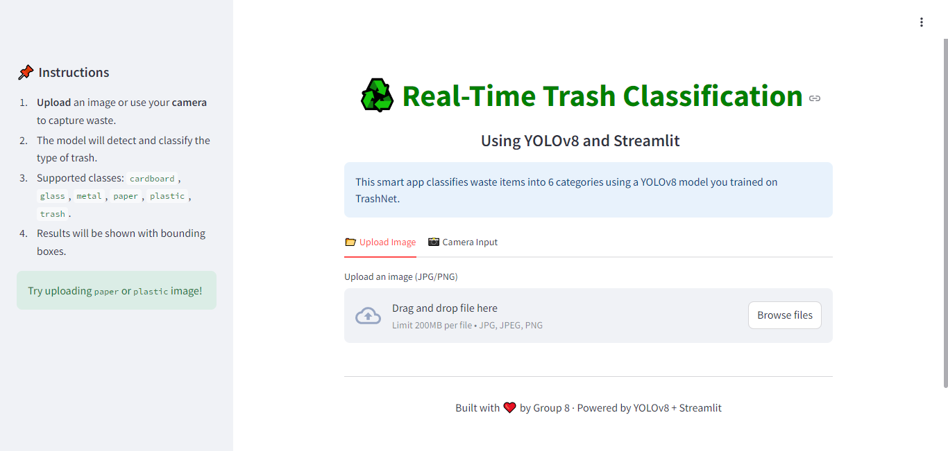
Deployment

Slide 21
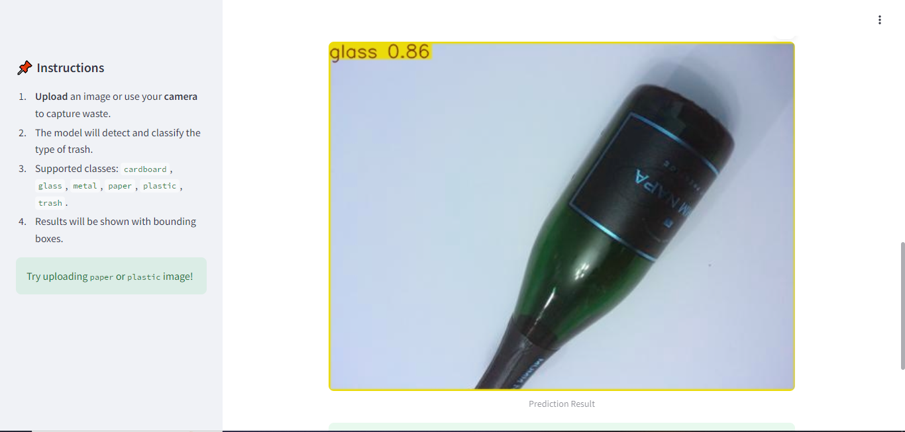
Deployment
Notes:
FTs like precision agriculture, remote sensing & AI-powered forming equipment can help increase agricultural productivity in LDCs. This can improve fiid security & contribute to the achievement of SDG 2 (Zero Hunger).

Slide 22
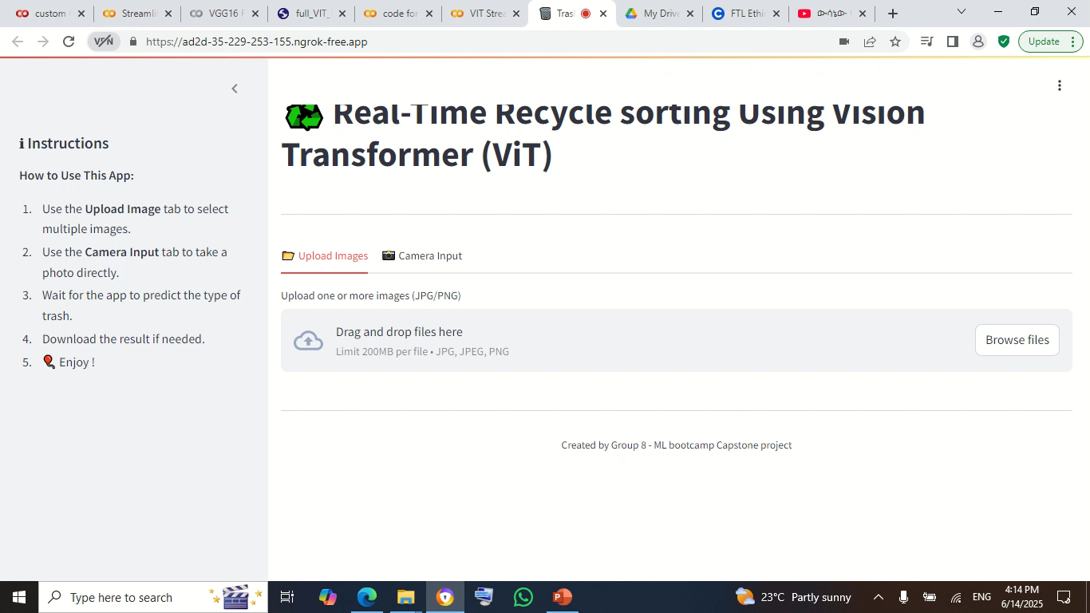
Deployment sample Video

Slide 23
Challenges and Mitigation
Challenge | Mitigation
Google Colab disconnections | Frequent checkpoints and model saving
ViT compatibility issues | Input resizing and custom loader
YOLO annotation conversion | Scripted conversion to YOLO format
Real-time latency | Used YOLOv8-nano with 640x640 input

Slide 24
Future Work
Real-World Deployment: Integrate the trained model with embedded hardware (e.g., Raspberry Pi, Jetson Nano) for on-site deployment.
Multi-Object Detection: Extend YOLOv8 implementation to handle multiple waste items in a single image/frame.
Backend Integration: Connect the Streamlit interface with a database/API for centralized monitoring and analytics.
Expanded Waste Categories: Incorporate more granular waste types (e.g., biodegradable vs. non-biodegradable).
Real-Time Video Stream Support: Upgrade to handle live camera feeds for dynamic sorting at conveyor belts or bins.

Slide 25
References
Deep Learning Model for Real‐time Identification of Various Types of Waste,Cleaner Waste Systems. Alam Rahmatulloh, Irfan Darmawan, Aldy Putra Aldya, Firmansyah Maulana Sugiartana Nursuwars. 2025, Vol. 10.
Yang, Thung and. kaggle. Trashnet. [Online] 2016. https://www.kaggle.com/search?q=TrashNet.
Waste classification using vision transformer based on multilayer hybrid convolution neural network,Urban Climate,. Fatma S. Alrayes, Mashael M. Asiri, Mashael S. Maashi, Mohamed K. Nour, Mohammed Rizwanullah, Azza Elneil Osman, Suhanda Drar, Abu Sarwar Zamani,. s.l. : urban climate, 2023, Vol. 49.
Tomra’s AI-powered sorting technology: Revolutionizing recycling: Revolutionizing recycling. [Online] 2023. https://www.tomra.com.
Artificial intelligence based classification for waste management: A survey based on taxonomy, classification & future direction. Dhanashree Vipul Yevle, Palvinder Singh Mann,Artificial intelligence based classification for waste management:. 2025, Vol. 56.
You Only Look Once: Unified, Real-Time Object Detection. . Redmon, J., Divvala, S., Girshick, R., & Farhadi, A. 2016, In Proceedings of the IEEE Conference on Computer Vision and Pattern Recognition (CVPR)., pp. 779–788.

Slide 26

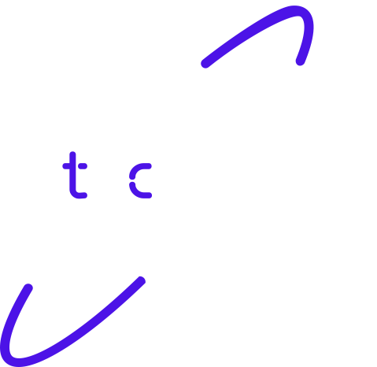
Thank you!

